Slide 1


13
Working with
Files
C# Programming: From Problem Analysis to Program Design
4th Edition

Slide 2
Chapter Objectives
Learn about the System.IO namespace
Explore the File and Directory classes
Contrast the FileInfo and DirectoryInfo classes to the File and Directory classes
Discover how stream classes are used
Read data from text files

Slide 3
Chapter Objectives (continued)
Write data to text files
Explore appending data to text files
Use exception-handling techniques to process text files
Read from and write to binary files

Slide 4
System.IO Namespace
Provides basic file and directory support classes
Contains types that enable you to read and write files and data streams
Many of the types or classes defined as part of the System.IO namespace are designed around streams

Slide 5
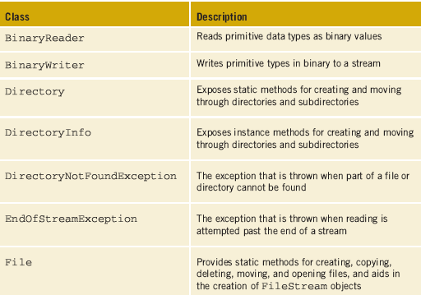
System.IO Namespace (continued)
Table 13-1 System.IO classes

Slide 6
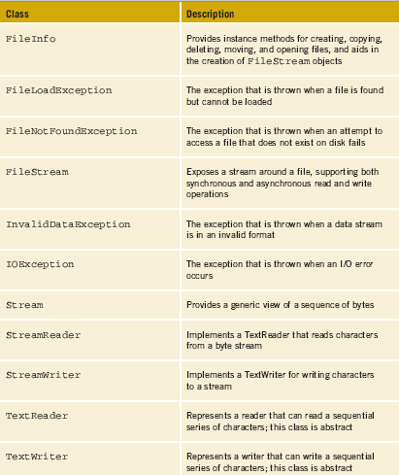
System.IO Namespace (continued)
Many are exception classes that can be thrown while accessing information using streams, files, and directories
Table 13-1 System.IO
classes (continued)

Slide 7
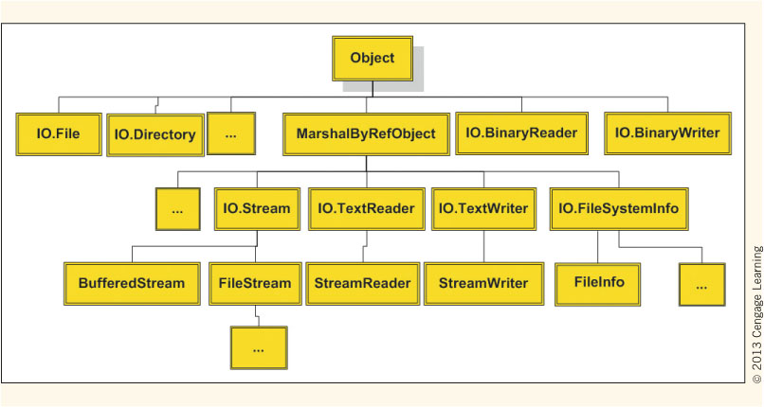
System.IO Namespace (continued)
Figure 13-1 .NET file class hierarchy

Slide 8
File and Directory Classes
Utility classes allow you to manipulate files and directory structures
Aid in copying, moving, renaming, creating, opening, deleting, and appending files
Expose only static members
Objects are not instantiated from these classes
To invoke the method, the method name is preceded by the class name (as opposed to an object’s name)
File.Copy("sourceFile", "targetFile");

Slide 9
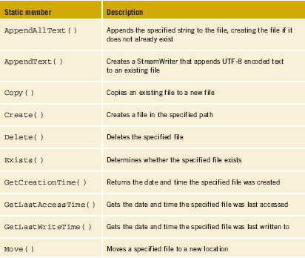
File Class
Table 13-2 File class static members

Slide 10
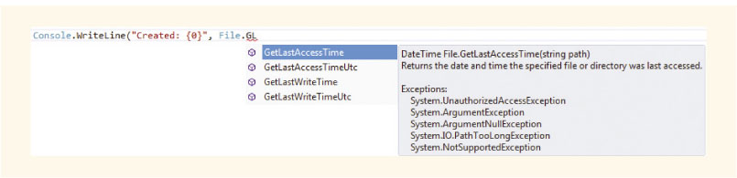
File Class (continued)
Visual Studio IntelliSense feature provides information
Figure 13-2 IntelliSense display

Slide 11
File Class (continued)
One static method of the File class is Exists( )
using System;
using System.IO; // Added for File Access
class DirectoryStructure
{
public static void Main( )
{
string fileName = "BirdOfParadise.jpg";
if (File.Exists(fileName))
{
Review DirectoryStructure Example

Slide 12
File Class (continued)
Enumeration - special form of value type that supplies alternate names for the values of an underlying primitive type
Enumeration type has a name and a set of fields
public enum DayOfWeek
{
Sunday, Monday, Tuesday, Wednesday,
Thursday, Friday, Saturday
}
Console.WriteLine("Today is {0 }!", DayOfWeek.Tuesday);

Slide 13
File Class (continued)
GetAttritubes( ) returns a enumeration
Enumerated values for FileAttributes include Archive, Compressed, Device, Directory, Encrypted, Hidden, Normal, ReadOnly, and System
Using enumerations makes coding simpler and the output more readable

Slide 14
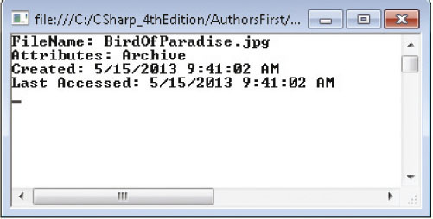
File Class (continued)
Console.WriteLine( "FileName: {0}", fileName );
Console.WriteLine( "Attributes: {0}", File.GetAttributes(fileName) );
Console.WriteLine( "Created: {0}", File.GetCreationTime( fileName ) );
Console.WriteLine( "Last Accessed: {0}", File.GetLastAccessTime(
fileName ) );
GetAttributes( ) returns enumeration
Figure 13-3 Output from the DirectoryStructure application

Slide 15
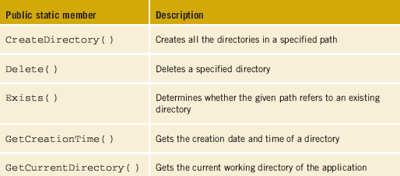
Directory Class
Static methods for creating and moving through directories and subdirectories
Table 13-3 Directory class members

Slide 16
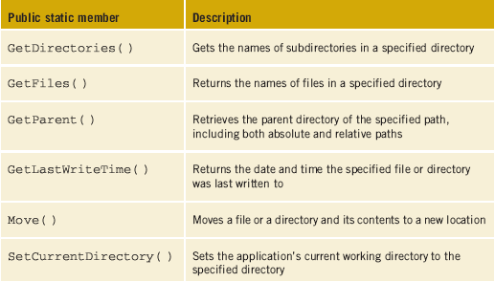
Directory Class (continued)
Table 13-3 Directory class members (continued)

Slide 17
DirectoryInfo and FileInfo Classes
Adds additional functionality beyond File and Directory classes
Difference – DirectoryInfo and FileInfo have instance methods instead of static members
Both have public properties and public constructors
Neither can be inherited

Slide 18
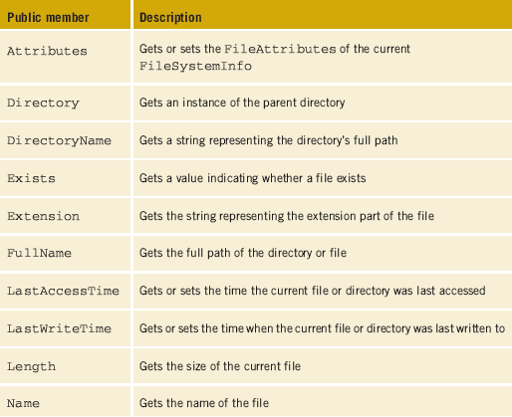
Table 13-4 FileInfo properties

Slide 19
DirectoryInfo
Adds two other key properties, Parent and Root
Parent gets the parent directory of a specified subdirectory
Root gets the root portion of a path
Be careful with paths; they must be well-formed or an exception is raised
DirectoryInfo dir = new DirectoryInfo(".");
Console.WriteLine("Current Directory: \n{0}\n",
Directory.GetCurrentDirectory( ));
Review DirectoryStructure Example

Slide 20
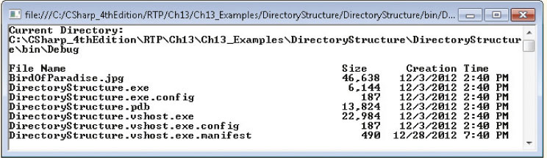
DirectoryInfo (continued)
Figure 13-4 Output from the revised
DirectoryStructure application
PadRight( ) method of the string class used to format file data returned by the FileInfo Name property

Slide 21
File Streams
Several abstract classes for dealing with files
Stream, TextWriter, and TextReader
Stream classes provide generic methods for dealing with input/output
IO.Stream class and its subclasses – byte-level data
IO.TextWriter and IO.TextReader – data in a text (readable) format
StreamReader and StreamWriter derived classes of IO.TextWriter and IO.TextReader

Slide 22
File Streams (continued)
StreamWriter class for writing data to text file
Includes implementations for Write( ) and WriteLine( )
StreamReader class to read or write to or from text files
Includes implementations of Read( ) and ReadLine( )
System.IO namespace must be imported for files
using System.IO;

Slide 23
File Streams (continued)
The bin\Debug or bin\Release subdirectory of the current project is used for file when you don’t specify a path
Use verbatim string character (@) or escape sequence (\\) to specify path
@"C:\CSharpProjects\Proj1"
"c:\\CSharpProjects\\Proj1"
If the file is stored in the same Visual Studio folder that holds the project and source code files, you would write @ "../../filename"
Indicates go up two directories from bin\Debug

Slide 24
File Streams (continued)
StreamWriter outputFile = new StreamWriter("someOutputFileName");
StreamReader inputFile = new StreamReader("someInputFileName");
outputFile and inputFile represent the file stream objects
Actual file names are “someOutputFileName” and “someInputFileName” – inside double quotes
Place file extensions such as .dat, .dta, or .txt onto the end of actual filename when it is created

Slide 25
File Streams (continued)
Use Write( ) or WriteLine( ) with the instantiated stream object
outputFile.WriteLine("This is the first line in a text file");
Use Read( ) or ReadLine( ) with the instantiated stream object
string inValue = inputFile.ReadLine( );

Slide 26
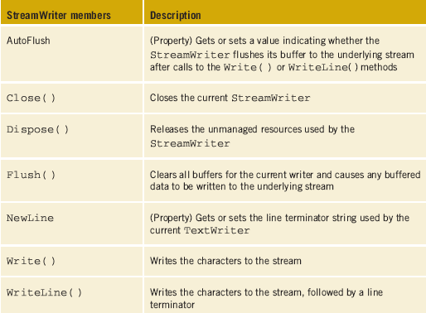
File Streams (continued)
Table 13-5 StreamWriter members

Slide 27
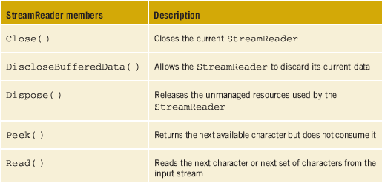
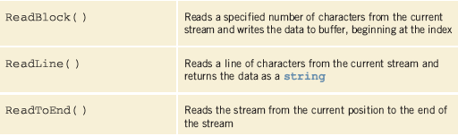
File Streams (continued)
Table 13-6 StreamReader members

Slide 28
Writing Text Files
Enclose attempts to access text files inside try…catch blocks
Constructor for StreamWriter class is overloaded
To Append data onto the end of the file, use the constructor with Boolean variable
fileOut = new StreamWriter("../../info.txt", true);
true indicates to append
Values are placed in the file in a sequential fashion
Close( ) method used to finish storing the values

Slide 29
Writing Text Files – SayingGUI Application
Three event-handler methods included
Form-load event handler, an object of the StreamWriter class is instantiated
Included in a try…catch clause
Button click event-handler method retrieves the string from the text box and writes the text to the file
Also enclosed in a try…catch clause
Form-closing event closes the file and releases resources associated with file
Also enclosed in a try…catch clause

Slide 30
Writing Text Files (continued)
using System.IO; // Added for file access
private StreamWriter fil; //Declares a file stream object
: // more statements needed
try
{
fil = new StreamWriter("saying.txt");
}
: // more statements needed
try
{
fil.WriteLine(this.txtBxSaying.Text);
this.txtBxSaying.Text ="";
}
Instantiate StreamWriter object
Retrieve value from text box; write it to the file
Review FrmSayingGUI Example

Slide 31
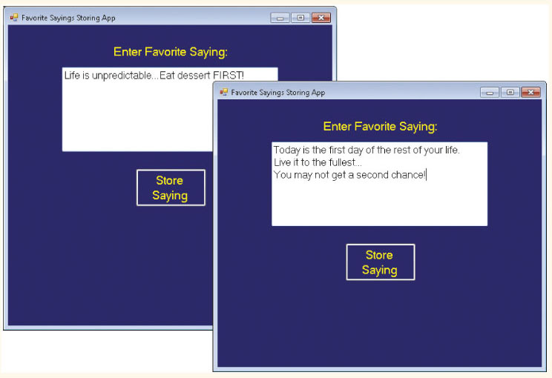
Writing Text Files (continued)
Figure 13-5 Data being stored in a text file

Slide 32
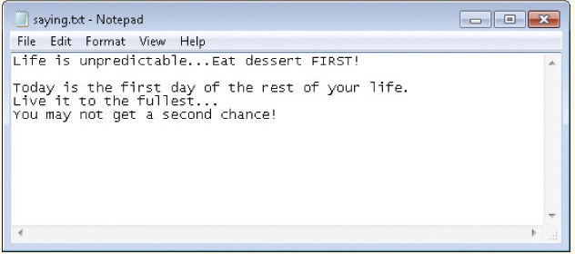
Writing Text Files (continued)
Figure 13-6 Contents of text file created
by SayingGUI application

Slide 33
Writing Text Files – SayingGUI Application (continued)
private void FrmSayingsGUI_Load(object sender, System.EventArgs e)
{
try
{
fil = new StreamWriter (@"C:\Bob\saying.txt"); // Invalid path
}
catch (DirectoryNotFoundException exc)
{
lblMessage.Text = "Invalid directory\n " + exc.Message;
}
Review FrmSayingGUI Example

Slide 34
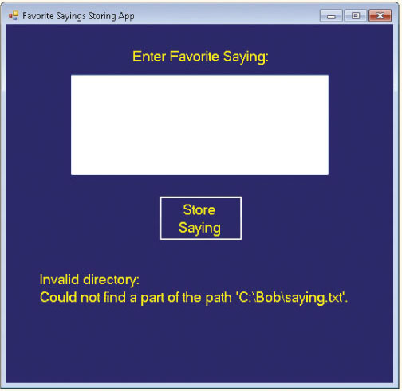
Writing Text Files – SayingGUI Application (continued)
If a path specified is invalid, an exception is throw
Figure 13-7 DirectoryNotFoundException thrown

Slide 35
Reading Text Files
StreamReader class enables lines of text to be read from a file
Constructor for StreamReader is overloaded
Can specify different encoding schema or an initial buffer size
Can use members of parent or ancestor classes or static members of the File class
To avoid programming catch for FileNotFoundException class or DirectoryNotFoundException class, call File.Exists(filename)

Slide 36
Reading Text Files (continued)
using System.IO; // Added for file access
private StreamReader inFile; // Declares a file stream object
: // more statements needed
if (File.Exists("name.txt"))
{
try
{
inFile = new StreamReader("name.txt");
while ((inValue = inFile.ReadLine()) != null)
{
this.lstBoxNames.Items.Add(inValue);
}
Retrieve values from file; place them in a ListBox
Review FileAccessApp Example

Slide 37
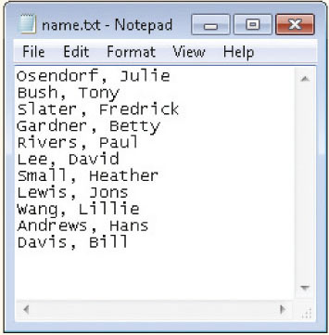
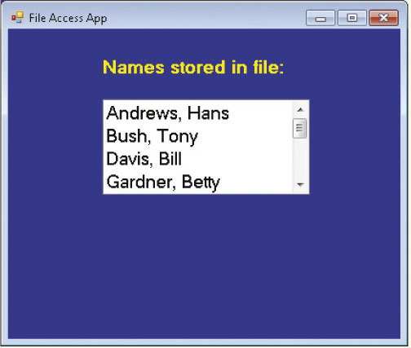
Reading Text Files –FileAccessApp Application
Read from text files in sequential fashion
Figure 13-8 Content of name.txt file
Figure 13-9 Output from
FileAccessApp

Slide 38
Adding a Using Statement
Define the scope for an object with the using keyword
CLR automatically disposes of, or releases, the resource when the object goes out of scope
using (Font aFont = new Font("Arial", 12.0f),
Customer c = new Customer( ))
{
// Statements referencing aFont and c
}
Attempts to reference aFont or c outside of the using block generate a compiler error

Slide 39
Adding a Using Statement (continued)
Useful when working with files or databases
When writing data to a file, the data is not stored in the file properly until the file is closed
If you do not close the file – you will find an empty file
With using block, not necessary for you to call the Close( ) method – automatically called by the CLR

Slide 40
Adding a Using Statement (continued)
try
{
using (StreamReader inFile = new
StreamReader("name.txt"))
{
while ((inValue =
inFile.ReadLine()) != null)
{
this.lstBoxNames.Items.Add(inValue);
}
}
StreamReader object defined and instantiated inside using block
inFile object exists only in this using block
Guaranteed the file is closed when you exit the using block
Review FileAccessAppWithUsing Example

Slide 41
Random Access
FileStream class also supports randomly accessing data
Values can be processed in any order
Fifth data record can be retrieved and processed before the first record
Accomplished using concept called seeking – Seek( ) is a member of the FileStream class
Seek( ) lets you move using an offset reference parameter
Offset can be relative to beginning, current position or end of file
Can use random access with text or binary files

Slide 42
BinaryReader and BinaryWriter Classes
BinaryWriter and BinaryReader classes used for writing and reading binary data, rather than character strings
Files created are readable by the computer
You cannot open and read binary files using Notepad
Program is needed to interpret the file contents

Slide 43
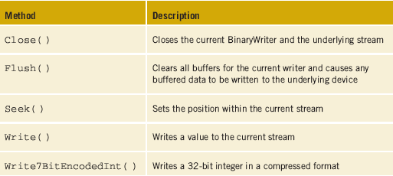
BinaryReader and BinaryWriter Classes (continued)
Table 13-7 BinaryWriter members

Slide 44
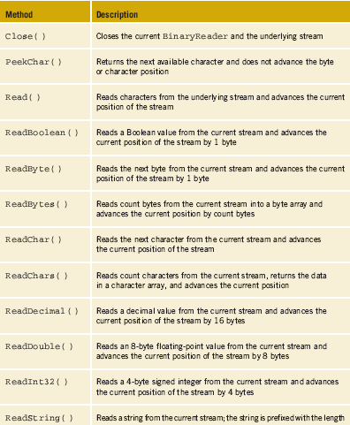
BinaryReader Class
Notice several Read( ) methods… each focused on the type of
data it would be retrieving
Table 13-7
BinaryReader
members

Slide 45
BinaryWriter Class
Objects are instantiated of the FileStream and BinaryWriter classes
FileStream filStream;
BinaryWriter binWriter;
BinaryWriter object is wrapped around the FileStream object
filStream = new FileStream(fileName, fileMode.CreateNew);
Second argument to the FileStream constructor is an enumeration

Slide 46
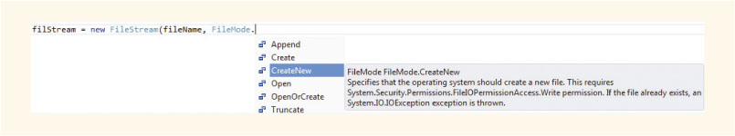
BinaryWriter Class (continued)
FileStream object is then sent in as an argument to the BinaryWriter constructor
binWriter = new BinaryWriter(filStream);
Figure 13-10 Enumerated FileMode

Slide 47
BinaryWriter Class (continued)
decimal aValue = 2.16M;
binWriter.Write("Sample Run");
for (int i = 0; i < 11; i++)
{
binWriter.Write(i);
}
binWriter.Write(aValue);
binWriter.Close( );
filStream.Close( );
First a string argument is written to the file
Then several integers are written to the file
Next a decimal value is written to the file
Finally both files must be closed
Both must be closed in order for the file to be created properly
Review BinaryFiles Example

Slide 48
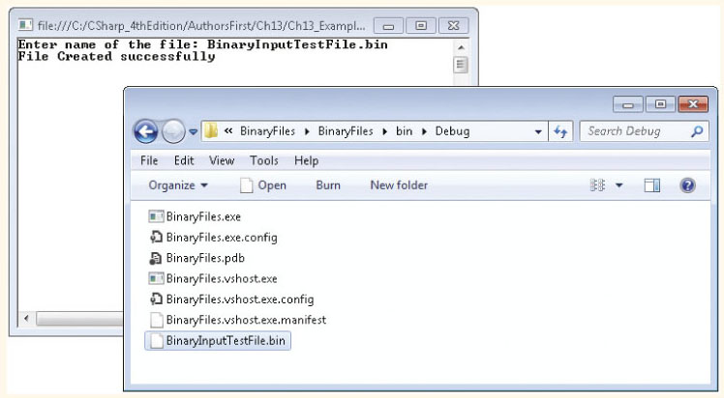
BinaryWriter Class (continued)
Figure 13-11 BinaryInputTestFile.bin file created

Slide 49
BinaryReader Class
Cannot simply open a binary file in Notepad and view its contents
Need to write program statements that use the BinaryReader class to retrieve the results.
FileStream filStream = new
FileStream(fileName, FileMode.Open, FileAccess.Read)
BinaryReader binReader = new BinaryReader(filStream);

Slide 50
BinaryReader Class (continued)
Constructor for the FileStream object includes values for two enumerated types
FileMode.Open and FileAccess.Read
FileAccess enumerations are Read, Write, and ReadWrite
Three different read methods were invoked to read data from the file for the example
ReadInt32( ), ReadDecimal( ) and ReadString( )
Review BinaryFileAccess Example

Slide 51
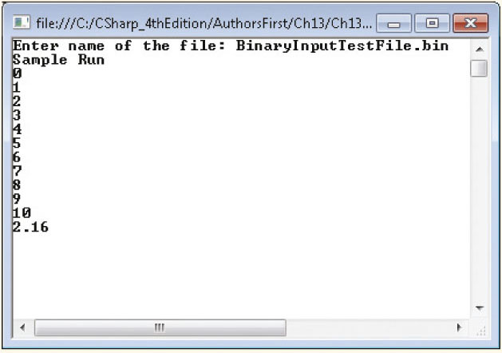
BinaryReader Class (continued)
Figure 13-12 Reading string, integer, and decimal data
from a binary file

Slide 52
Other Stream Classes
NetworkStream class provides methods for sending and receiving data over stream sockets
Methods similar to the other stream classes, including Read and Write methods
MemoryStream class used to create streams that have memory as a backing store instead of a disk or a network connection
Reduce the need for temporary buffers and files in an application

Slide 53
FileDialog Class
Enables browsing to a specific location to store or retrieve files
Displays Open file dialog box to allow user to traverse to the directory where the file is located and select file
Displays a Save As dialog box to allow user to type or select filename at run time
OpenFileDialog and CloseFileDialog classes
Classes are derived from the FileDialog class
FileDialog is an abstract class

Slide 54
FileDialog Class (continued)
FileName property is used by OpenFileDialog and CloseFileDialog
Set or get the name of the file from the dialog box
Drag the OpenFileDialog and/or the CloseFileDialog control from the toolbox onto your form
Placed in the component tray

Slide 55
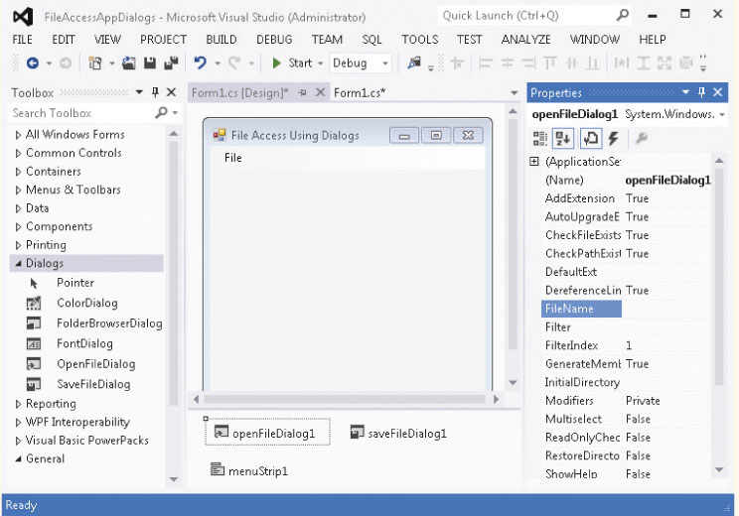
FileDialog Class (continued)
Figure 13-13 Placing OpenFileDialog and SaveFileDialog controls

Slide 56
FileDialog Class (continued)
ShowDialog( ) method used to cause the dialog boxes to appear
openFileDialog1.ShowDialog( ); or
saveFileDialog1.ShowDialog( );
To retrieve the filename from the textbox in the dialog box, use the FileName property
Retrieved value can be used as the argument for the stream object instantiation
StreamReader inFile = new StreamReader(openFileDialog1.FileName);
Review FileAccessAppDialogs Example

Slide 57
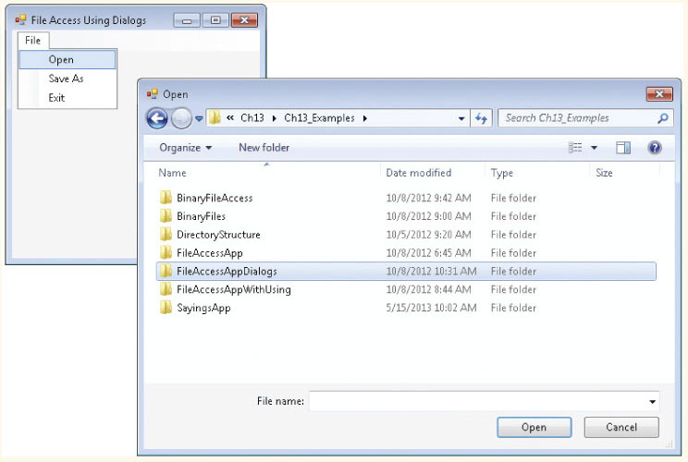
FileDialog Class (continued)
Figure 13-14 ShowDialog( ) method executed

Slide 58
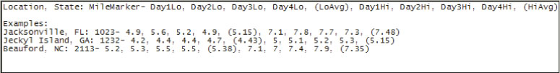
ICW WaterDepth File App Example
Graphical user interface solution was designed for application in Chapter 12
Review the problem specification in Figure 12-21
Solution modified to allow results to be captured and stored in a file for future use
Data stored in a text file
Figure 13-15 Data file prototype

Slide 59
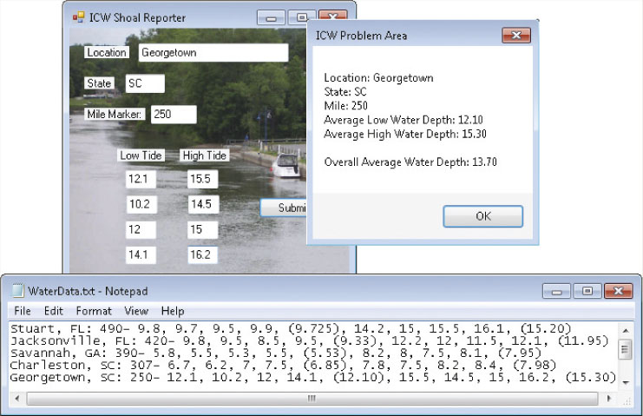
ICW WaterDepth File App Example
Figure 13-16 Values stored in a text file

Slide 60
Coding Standards
Good style improves the maintainability of the software
Include exception-handling techniques to deal with file or directory not found types of problems
System.IO namespace should be added for files
Always close files that are opened in applications

Slide 61
Resources
C# Code Style Guide –
http://www.sourceformat.com/pdf/cs-coding-standard-bellware.pdf
C# Station - How to: Reading and Writing Text Files –
http://www.csharp-station.com/HowTo/ReadWriteTextFile.aspx
Dot Net Perls - C# File Handling –
http://dotnetperls.com/file-handling

Slide 62
Chapter Summary
System.IO namespace
File and Directory classes
Static members
Copy, move, append to, and rename files
Create, delete, and rename directories
FileInfo and DirectoryInfo classes
Added functionality to File and Directory classes
Instantiate objects of these classes

Slide 63
Chapter Summary (continued)
StreamWriter class
StreamReader class
BinaryReader and BinaryWriter classes
Create and access binary (non-readable) files
FileDialog classes
OpenFileDialog
CloseFileDialog
ShowDialog used to display dialog box

